Slide 1
NCLA YSS Diversity Grant Appalachian Regional Library Watauga County Public Library
{"A?":"B","a":5,"d":"B","h":"www.canva.com","c":"DAEGG732cCs","i":"LCRgWvdvjMlKiNJDri0K7A","b":1599147761446,"A":[{"A?":"I","A":331.20148607470225,"B":528.0282813092126,"D":974.2846216016802,"C":707.5742064382201,"a":{"B":{"A":{"A":"MAD":{"D":974.2846216016802,"C":707.5742064382201}}}}],"B":1920,"C":1080}
“I feel it is my duty to not have the collection reflect my community, but rather to reflect the wider world.”
School Library Journal
Can Diverse Books Save Us?
{"A?":"B","a":5,"d":"B","h":"www.canva.com","c":"DAEGG732cCs","i":"LCRgWvdvjMlKiNJDri0K7A","b":1599147761446,"A":[{"A?":"I","A":331.20148607470225,"B":528.0282813092126,"D":974.2846216016802,"C":707.5742064382201,"a":{"B":{"A":{"A":"MAD-3ppZwXk","B":1},"B":{"D":974.284621

Slide 2
Community Driven I started out in one direction and ended up in another because of lingering memory of words... in a random conversation someone once said how people would not look or talk to her husband because he was in a wheelchair…

Slide 3
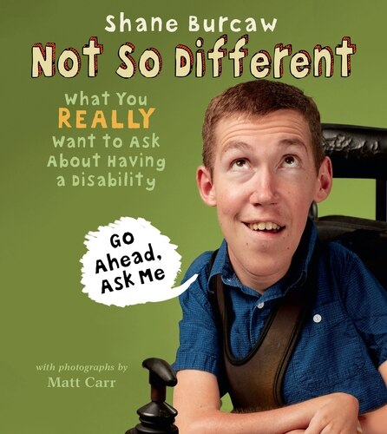
“Teaching children that all people deserve kindness and respect, regardless of their differences, while providing equipment grants to those living with muscular dystrophy.”

Slide 4
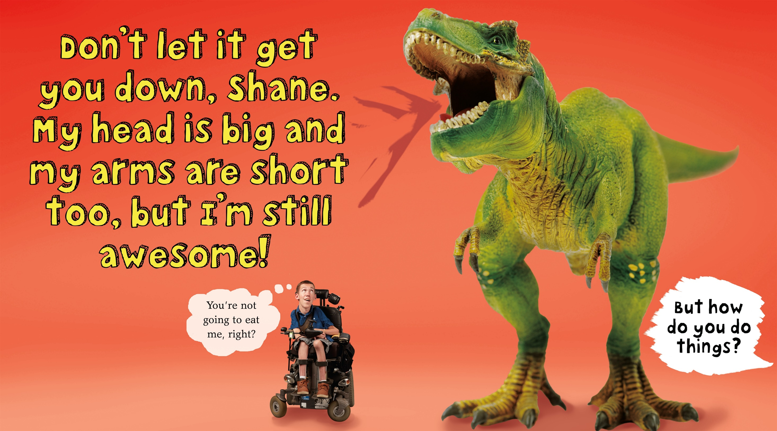

Slide 5
Skype with Shane!
Why bring Shane to your classroom?
https://www.laughingatmynightmare.com/skype-shane
Foster understanding and respect.
One of the most important ideas children can learn is that we are all different. We all have unique strengths, weaknesses, and abilities, and that’s not just okay, it’s beautiful. Exposing children to people from a variety of backgrounds provides them with the important lesson that all people should be treated with kindness and respect. Interacting with Shane will give your students valuable first-hand experience with someone who they may see as "different.”
​
Kids are curious about disability.
The most common question we receive from parents and educators is: "What should I do to help my child become more aware about people who live with disabilities?" Children are so curious when they see someone in public using a wheelchair, but it's difficult for many parents to answer the questions their children have. Our Not So Different programs are designed to let curiosity flourish in a safe environment where kids are encouraged to ask Shane anything they might wonder about his life and his disease.

Slide 6
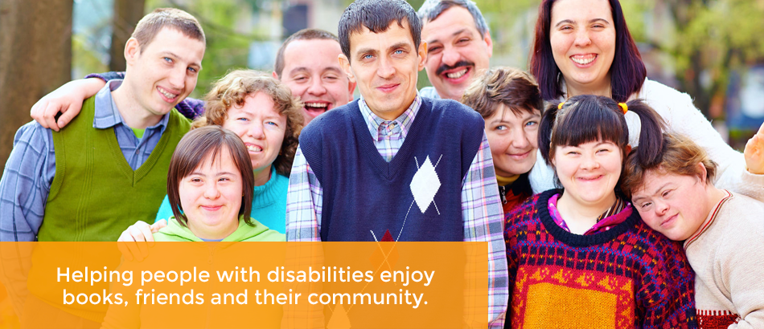
Next Chapter Book Club
https://www.nextchapterbookclub.org
There is a one-time fee of $350 which includes online training for the affiliate organization (2 1/2 hours), technical assistance and access to the NCBC online portal for information exchange and materials. Libraries have used their local budget, support from Friends' groups and other sources to fund participation.

Slide 7
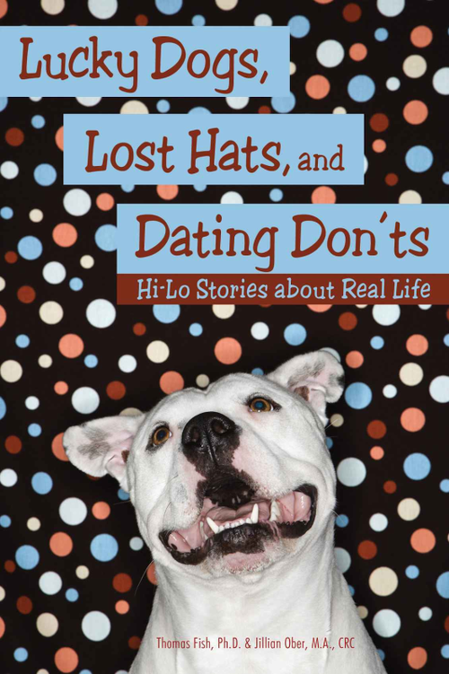
“Like everyone, the developmentally disabled community wants a safe place to continue learning, sharing, and growing intellectually throughout their lives. The public library is in a unique position to be that place, and the rewards will be great for the whole community.“

Slide 8
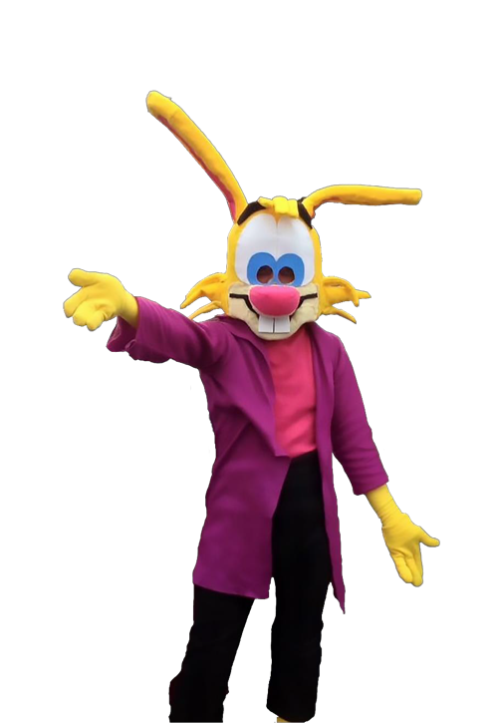
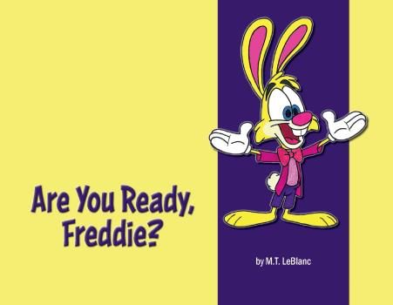
ASU student M. T. LeBlanc author Are You Ready Freddie?
“Autism’s “aging-out” crisis is very real and growing. A 2012 study in Pediatrics found that after leaving high school, young adults on the spectrum were three times more likely to be disengaged from the community and work, compared with people with serious mental illness or cognitive disabilities. Even though therapies and activities for young children with autism are starting to grow, programs for teens and young adults are still scarce.”

Slide 9
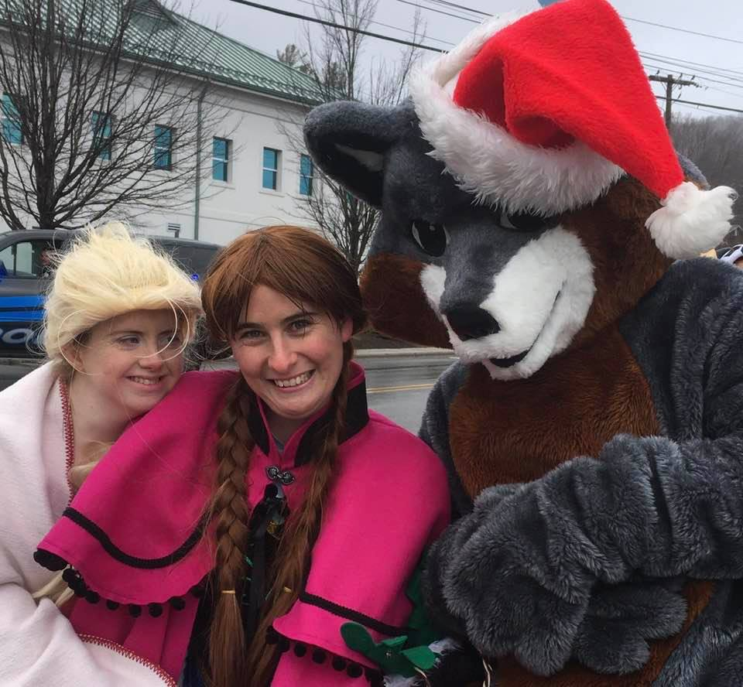
Appalachian Scholars with Diverse Abilities Program aims to prepare college-aged students with intellectual disabilities for personal growth and occupational success. The goal upon completion of the two-year program is that students obtain competitive, integrated employment and live independent, fulfilling lives.
Parades, crafts, de-stickering books and story times.
http://www.aucd.org/docs/add/sa_summits/Language%20Doc.pdf

Slide 10
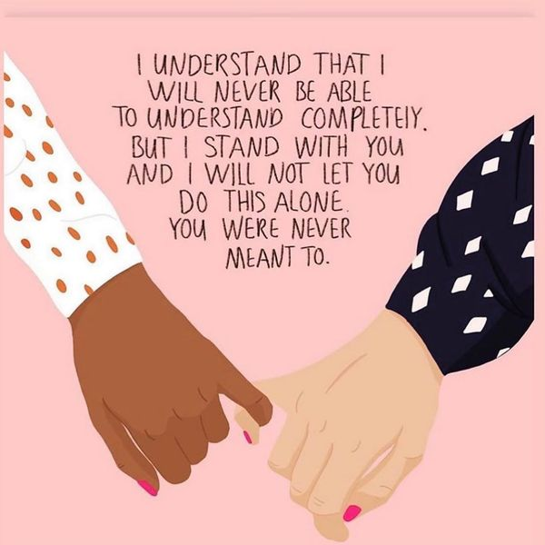
Neurodiversity is a concept that’s been around for a while. In a nutshell, it means that brain differences are just that: differences. So conditions like ADHD and autism aren’t “abnormal.” They’re simply variations of the human brain.
https://www.understood.org/en/friends-feelings/empowering-your-child/building-on-strengths/neurodiversity-what-you-need-to-know

Slide 11
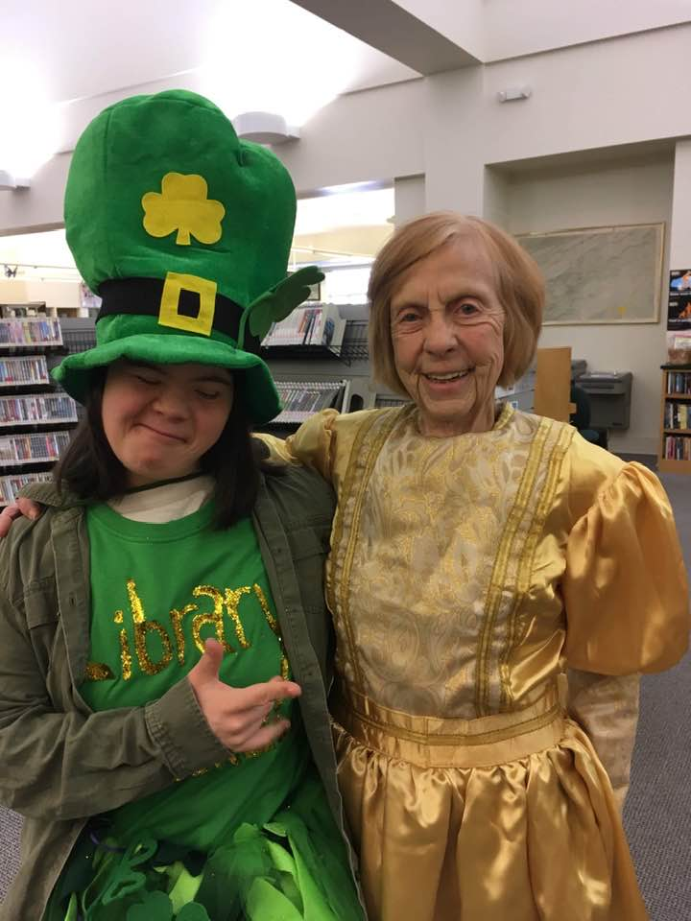
Why Kids Need Book Characters They CANNOT Relate To
While it is important for children to see book characters they can relate to, it’s also important for them to see characters that are not like them. Children should also be exposed to characters they cannot relate to. They need to understand that not everyone is like them and that’s okay.
https://teachingexceptionalthinkers.com/2020/02/04/books-about-disabilities/
Deafo

Slide 12
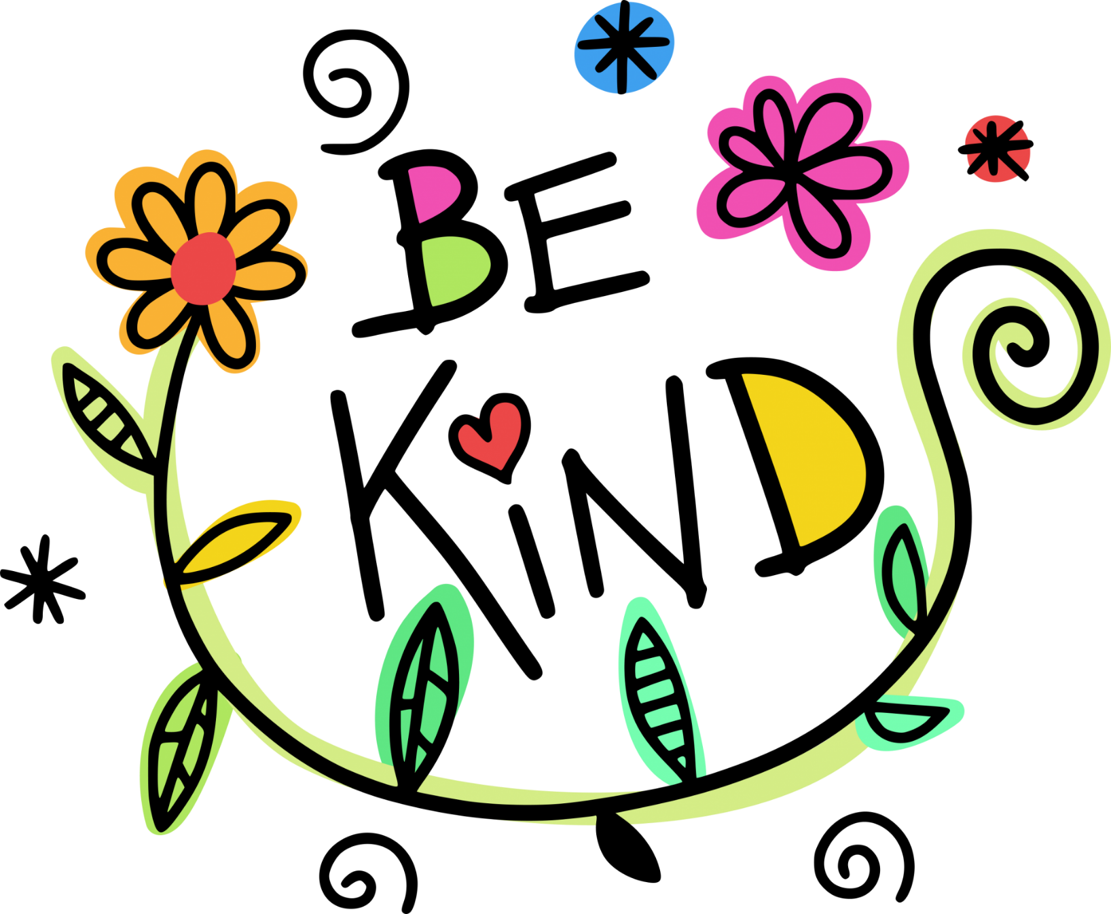

Slide 13
Books
I am Human: a Book of Empathy by Susan Verde
The Black Book of Colors by Menena Cottin
I am Not a Label by Cerrie Burnell
El Deafo by Cece Bell
Roll With It by Jamie Sumner
Be Good to Eddie Lee by Virginia Fleming
Just As Be Different, Be Brave by Sonia Sotomayor
I’m Here by Peter Reynolds
It’s OK to be Different by Todd Parr
Whoever You Are by Mem Fox
I’m Gonna Push Through! By Jasmyn Wright * wepushthough.org
Dictionary for a Better World by Irene Lathem & Charles Waters
Website
https://americanlibrariesmagazine.org/2016/04/29/libraries-autism-services-aging-sensory-storytime/

