Slide 1
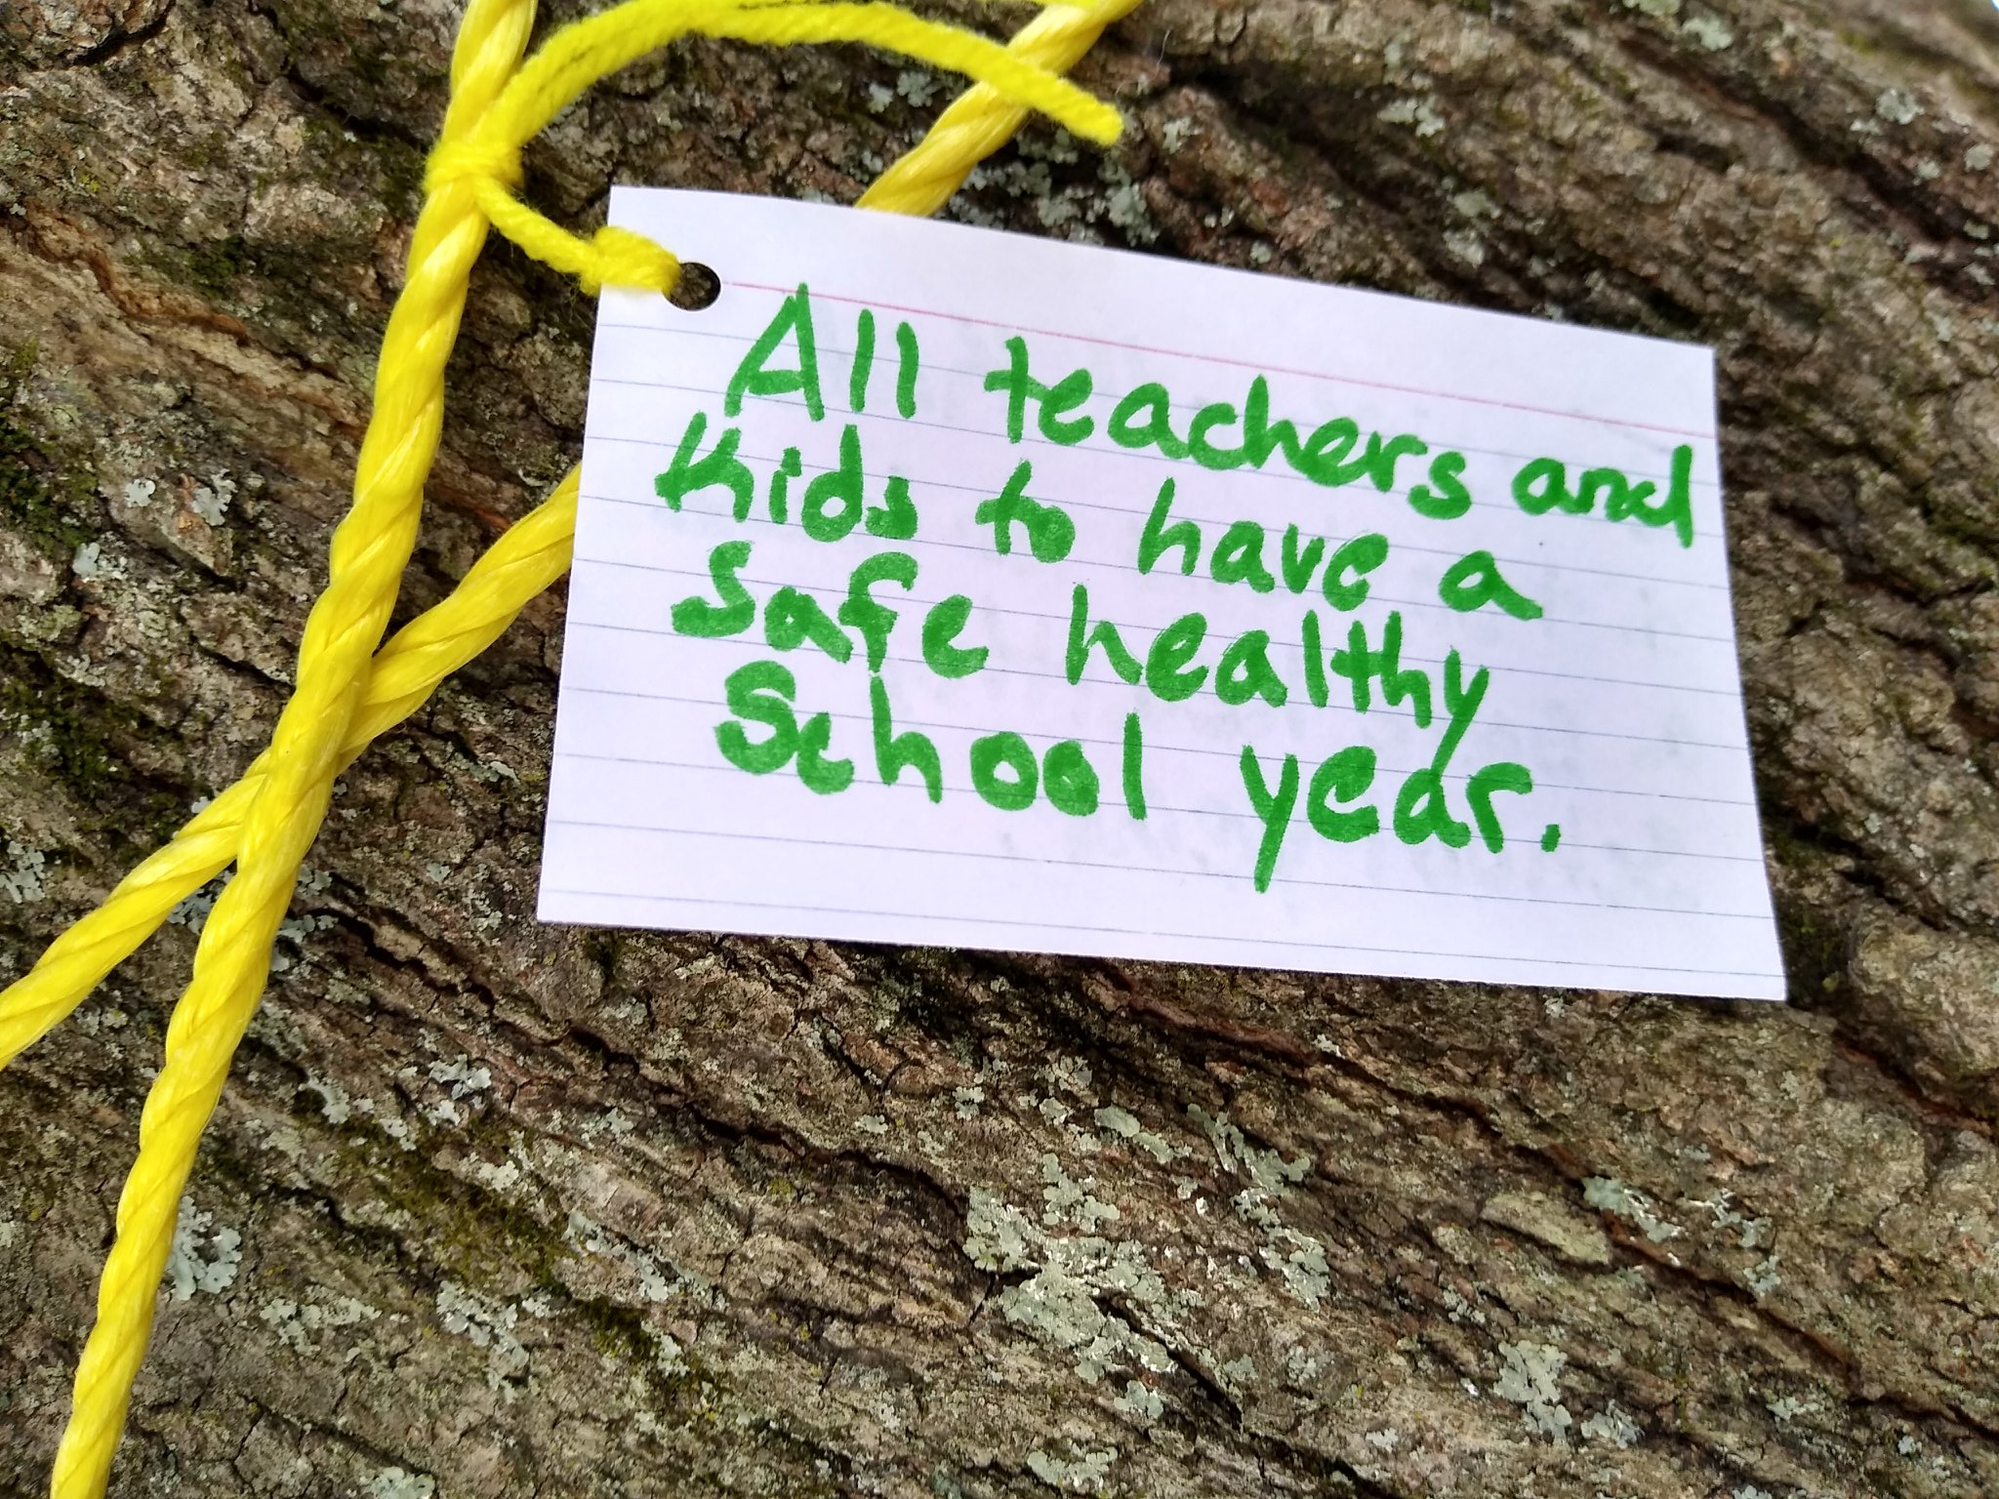
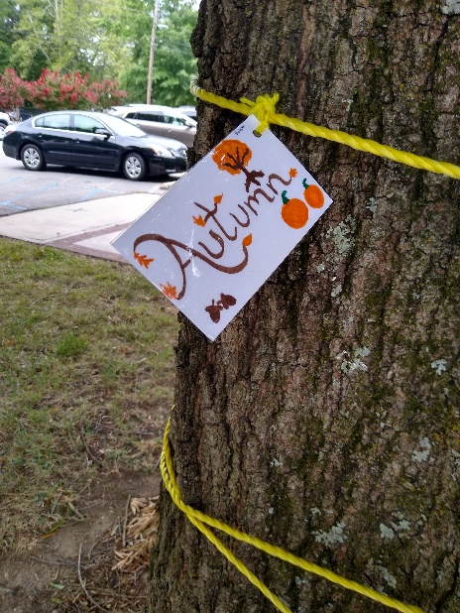
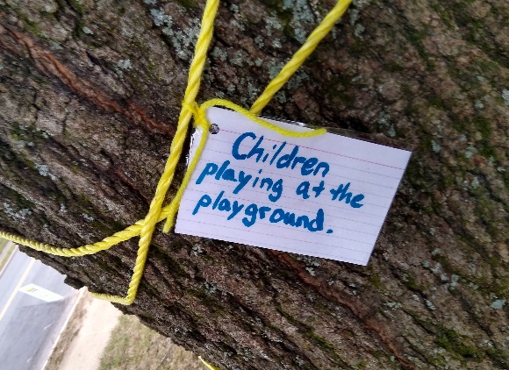
Person County Public Library
Amanda Weaver, Children’s Librarian

Slide 2
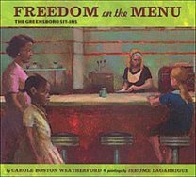
The COVID Change:
Community Read of “Ruth and the Green Book” By Calvin Ramsey and “Freedom on the Menu” By Carole B. Weatherford.
Writing contest for Tweens and Teens on Diversity in fiction.

